Slide 1

Machine Learning Modeling
Thomas O’Gara

Slide 2

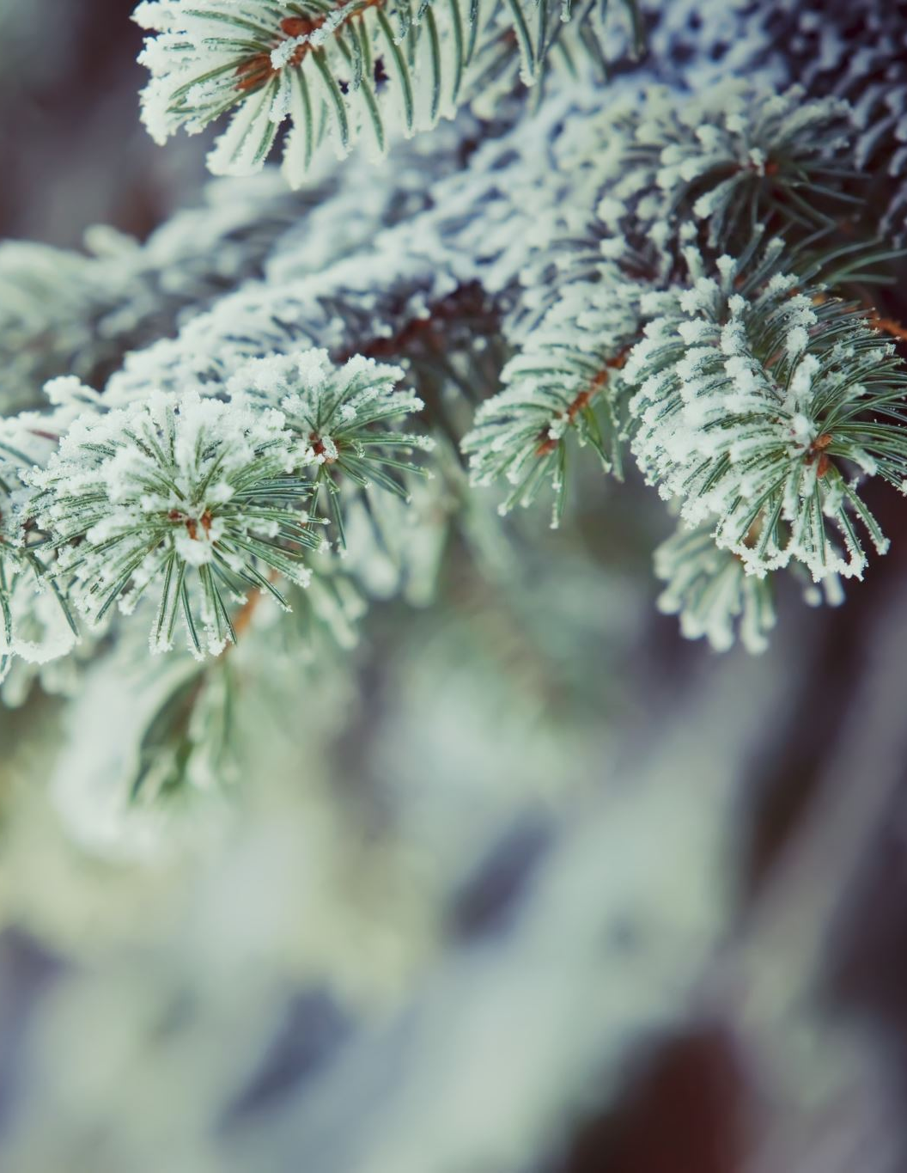
Forest Cover Types
1 - Spruce/Fir 2 - Lodgepole Pine 3 - Ponderosa Pine 4 - Cottonwood/Willow 5 - Aspen 6 - Douglas-fir 7 - Krummholz

Slide 3
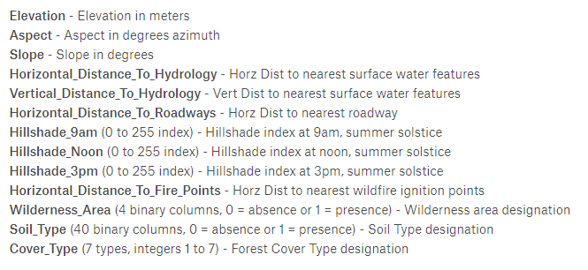
Data Set
https://www.kaggle.com/c/forest-cover-type-prediction

Slide 4
Stakeholder Deliverable
Predict the forest cover type (classification problem)
Choose the most “accurate” model

Slide 5
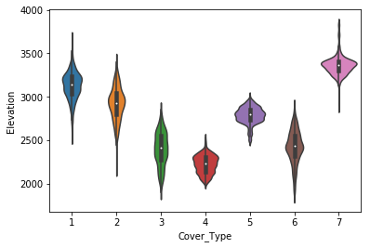
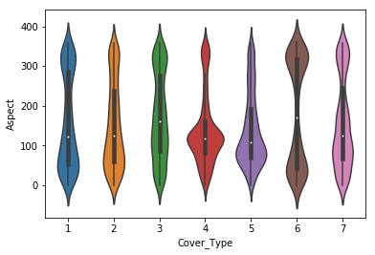
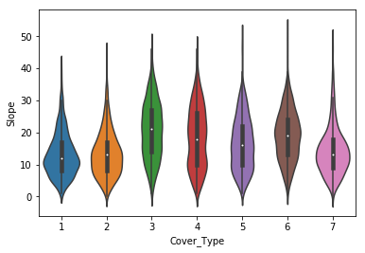
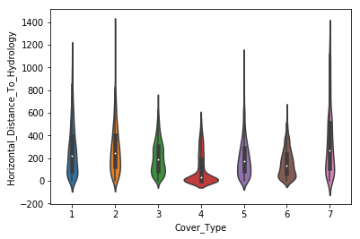
Feature Exploration

Slide 6
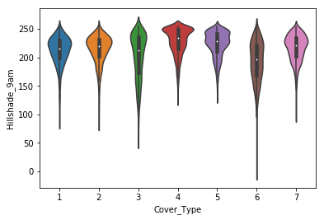
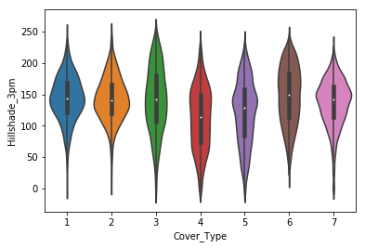
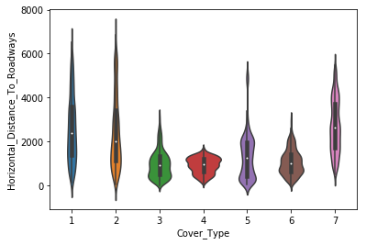
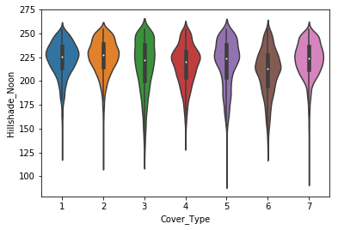
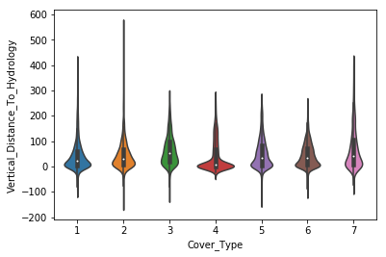
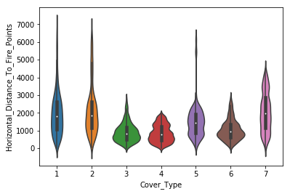

Slide 7
Machine Learning Model Recommendation
Random Forest
XGBoost

Slide 8

Random Forest
79% accuracy overall
Over 80% accuracy predicting cover types 3, 4, 5, 6, 7
Weaker accuracy predicting cover types 1, and 2
Drawback: More complexity

Slide 9
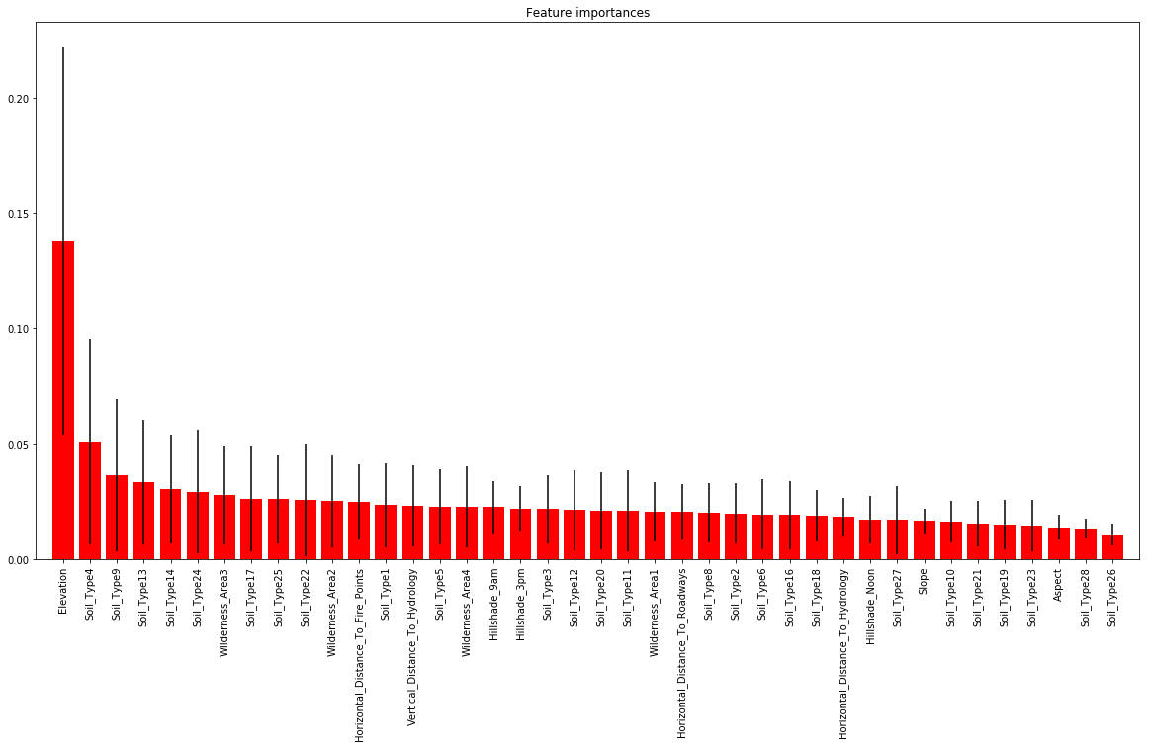
Feature importance for Random Forest

Slide 10
XGBoost
79% accuracy overall
Over 80% accuracy predicting cover types 4, 5, 7
Weaker accuracy predicting cover types 1, 2
Less complexity/run-time
Drawback: not as accurate for individual Forest Covers

Slide 11
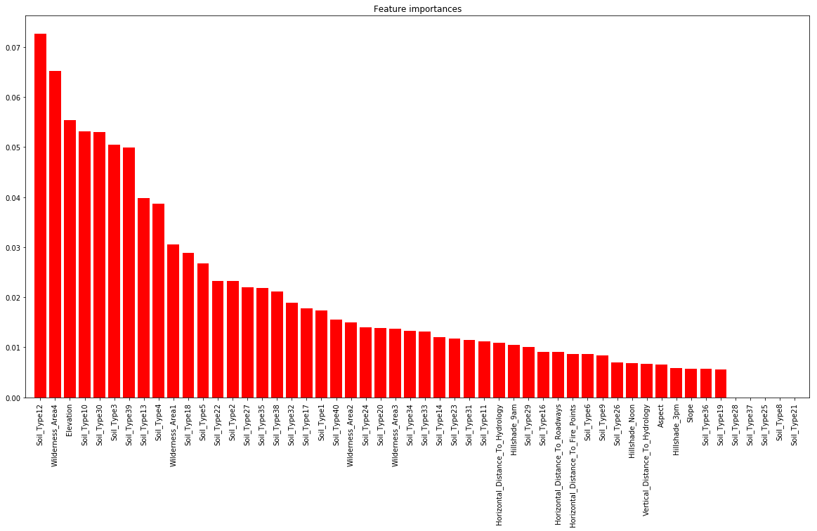
Feature importance for XGBoost

Slide 12

Questions?

